Slide 1

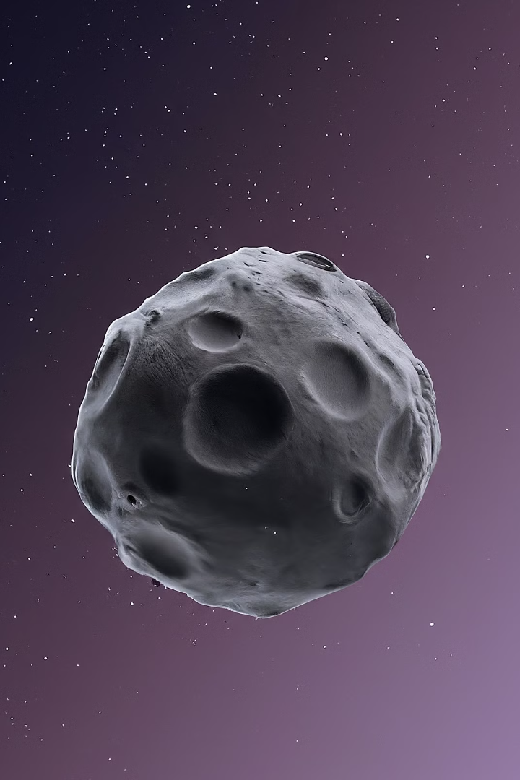
Asteroid Data Classification and Prediction Through
Parallel Computing
By
Akshit Hasmukh Kumar Jain (002876444)
Uday Kiran Dasari (002819106)

Slide 2
Agenda
1
Background
2
Motivation
3
Goal
4
Dataset Details
5
Data Preprocessing and Feature Extraction
6
Serial Execution vs. Parallel Execution on CPUs
7
Execution time for Models
8
Speedup and Efficiency
9
Conclusion

Slide 3
Introduction
Background
Did you know that we discover over 1,000 new asteroids every year?
Asteroids are leftover rocky debris from the formation of our solar system billions of years ago.
They come in various sizes, with some potentially posing a threat to Earth.
Accurately identifying and tracking asteroids is crucial for planetary defense and scientific research.
The insights derived from such research can assist space agencies, researchers, and policymakers in devising effective strategies

Slide 4
Introduction
Motivation
Predicting the future orbits and paths of asteroids can help us anticipate potential collisions and mitigate risks.
By leveraging advanced data analysis techniques, we can enhance our ability to predict and classify the trajectory and properties of asteroids, thus enabling better preparedness and mitigation strategies.
This project aims to contribute to the ongoing efforts to safeguard our planet from potential asteroid impacts and to deepen our knowledge of the cosmos

Slide 5
Introduction
Goal
To develop the ML models with significantly reducing the computation time using Parallel methods.
To pave the way for the development of more robust and accurate predictive models.
Handle Growing Datasets: Efficiently analyze the ever-increasing data on asteroids discovered every year.
Boost Classification Speed: Train and classify asteroids using Dask
Speeding Up Space Exploration: By parallel computing we can expedite the space missions.

Slide 6
Dataset Details
Data Sources
Data Attributes
Data Challenges
Sourced from Kaggle.
The dataset comprises of 958524 records and 45 columns.
The dataset is available in the Jet Propulsion Laboratory of NASA.
The dataset covers a wide range of asteroid properties, such as size, shape, composition, rotation, and orbital parameters.
There are 13 classes of Asteroids.
The dataset is large and complex, with missing values, noise, and outliers that require careful preprocessing and handling.

Slide 7

Parallel Data Loading Approach
1
Data Partitioning
Divide the dataset into smaller chunks to be processed concurrently across multiple processors.
2
Parallel I/O
Utilize parallel file I/O techniques to load the partitioned data efficiently in a distributed manner.
3
Coordinated Processing
Synchronize the processors to ensure the correct assembly and merging of the partial results.

Slide 8

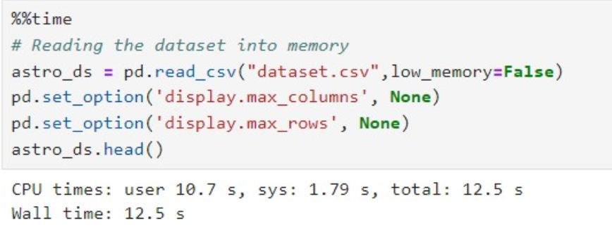
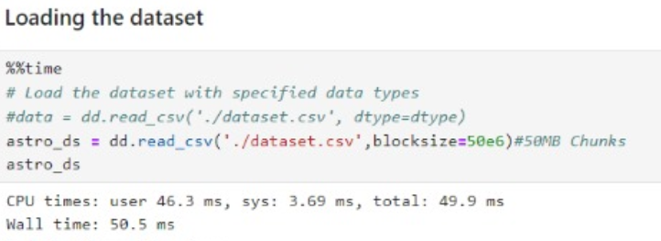
Data Loading Parallelization
Serial Data Loading
1
Employing Pandas to load the dataset.
2
Parallel Data Loading
Leveraging Dask Dataframe framework to load and preprocess data in parallel.

Slide 9
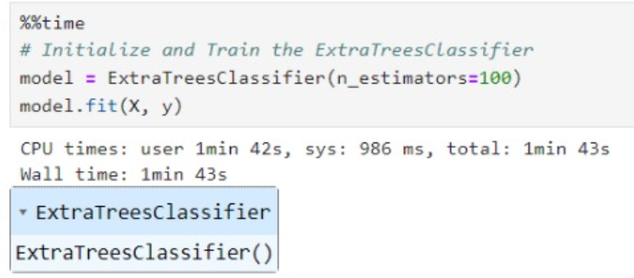
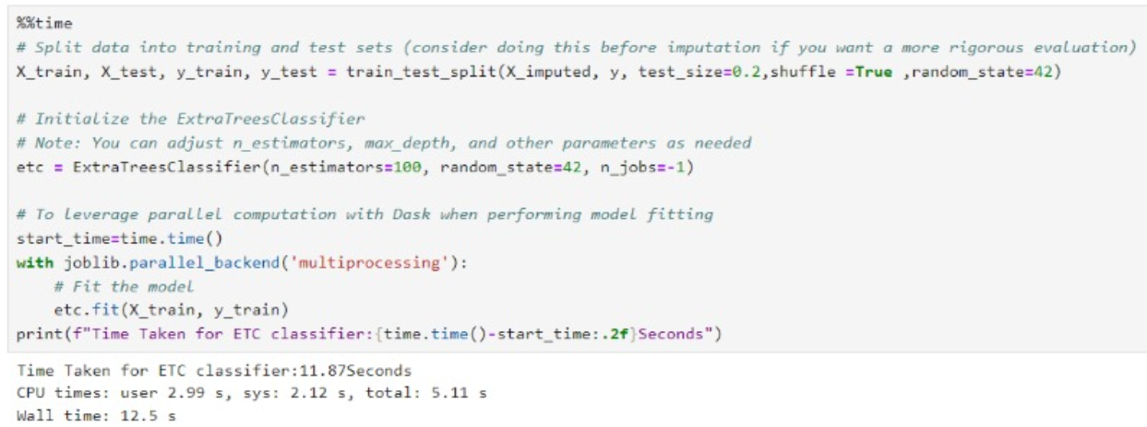
Feature Extraction
1
Serial
2
Parallel
Approach
Execution Time
Speed Up
Serial Execution
103 seconds
Serial Execution Time / Parallel Execution Time = 8.24x
Parallel Execution
12.5 seconds

Slide 10
Machine Learning Models
Develop models to accurately classify asteroids based on their physical and orbital characteristics.
Models trained on multi-CPUs:
Random Forest
KNN
XGBoost
Neural Network using data parallelism, Distributed data parallel

Slide 11




Performance Comparison: Serial vs. Parallel (CPU)
Serial Execution
Parallel Execution (CPU)
Speedup and Efficiency
The traditional approach of processing the data sequentially on a single CPU.
Leveraging multiple CPUs in parallel to accelerate the data processing and model training.
Analyze the performance gains and resource utilization to quantify the benefits of the parallel approach.

Slide 12
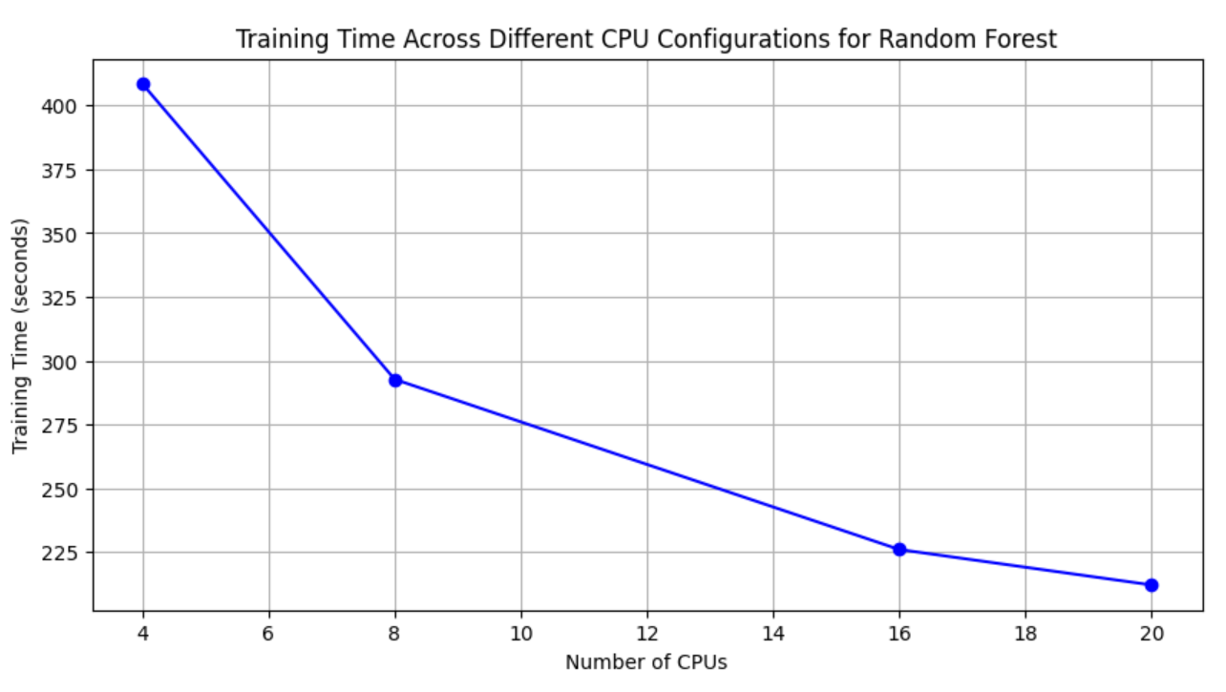
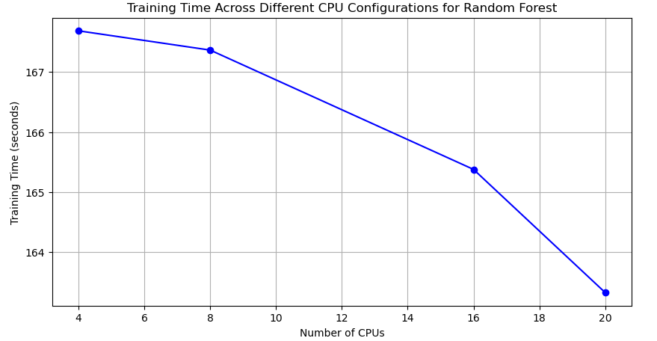
Random Forest Model on Multi-CPUs
1
Dask
2
Multiprocessing

Slide 13
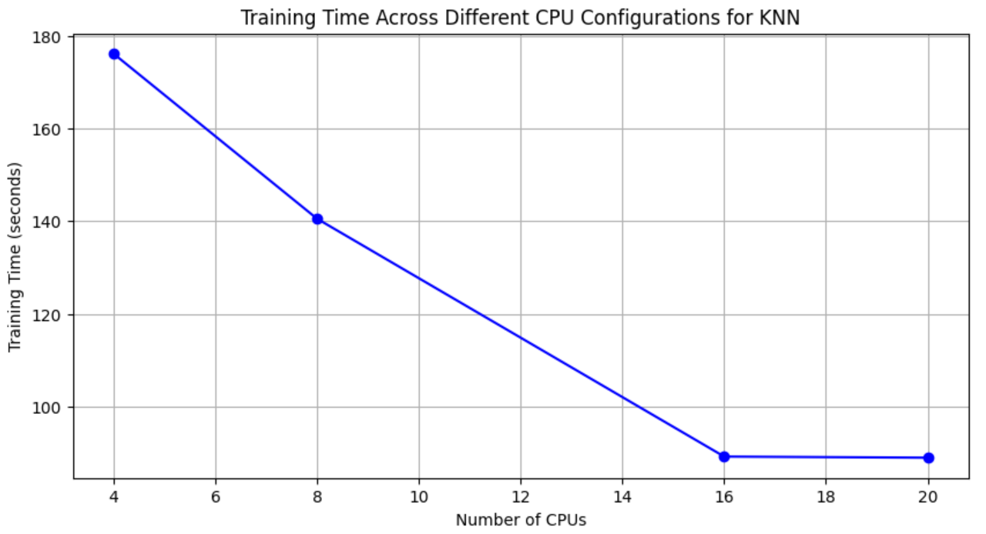
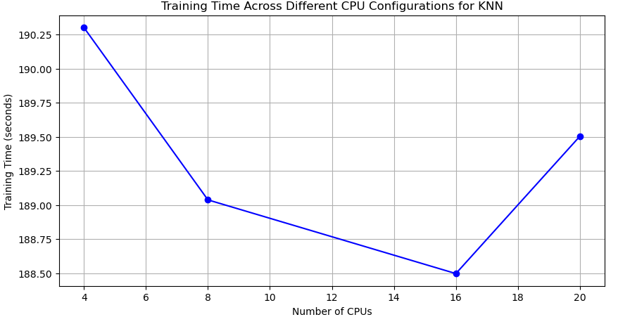
KNN model on Multi-CPUs
1
Dask
2
Multiprocessing

Slide 14
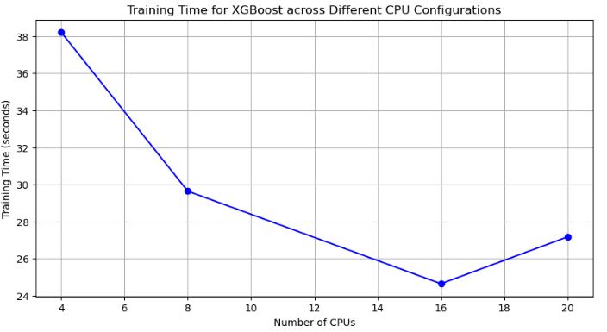
XGBoost model on Multi-CPUs
Using DaskXGBoost as the library

Slide 15
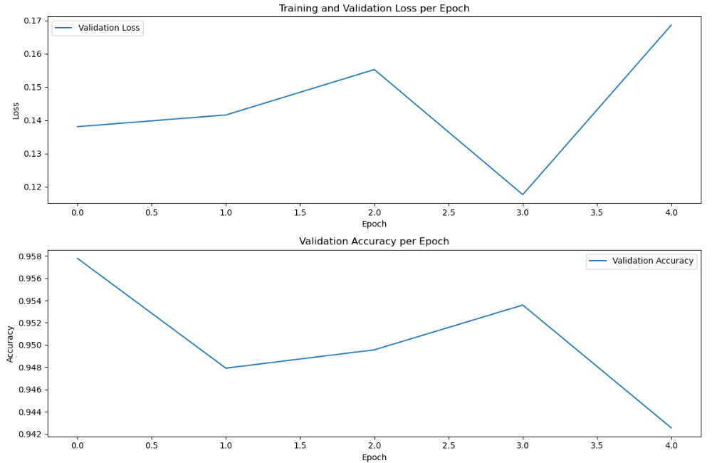
Neural Network using Data Parallelism
Using 24 CPUs

Slide 16
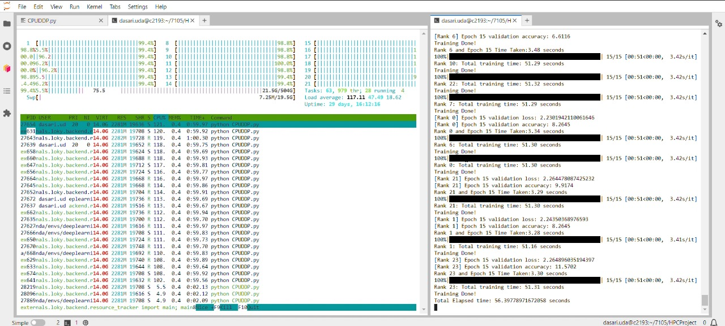
Neural Network using Distributed Data Parallelism
Time Elapsed: 56.39 for 24 CPUs

Slide 17
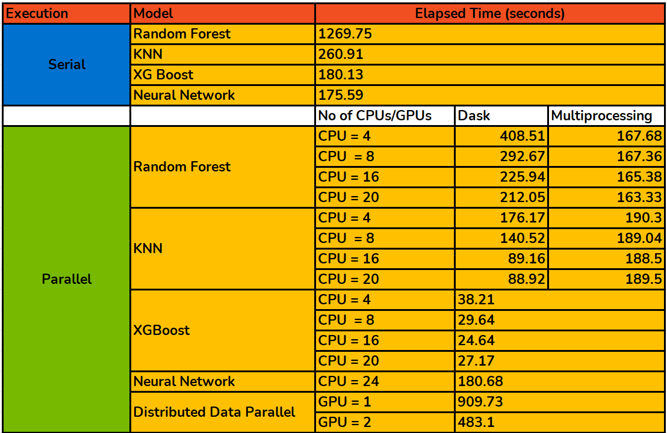
Execution time for Models

Slide 18
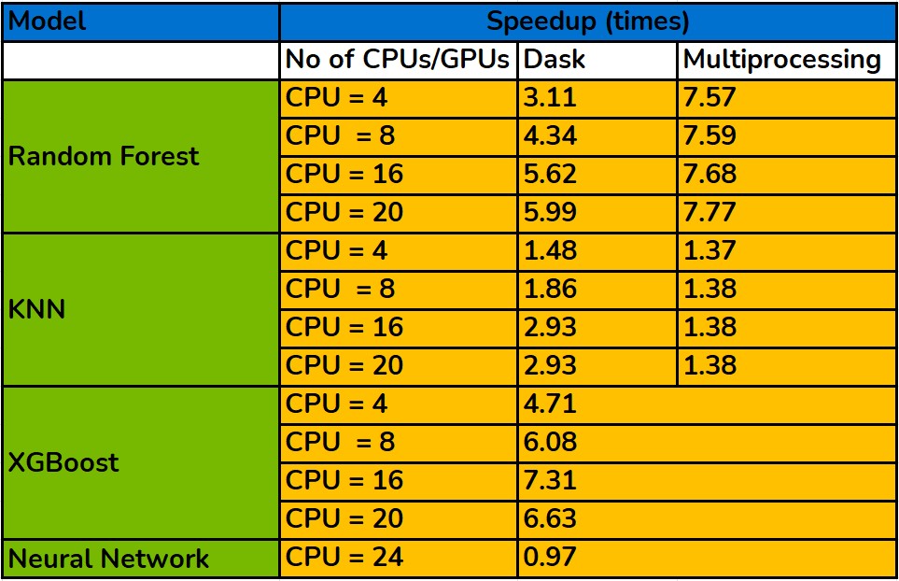
Speedup

Slide 19
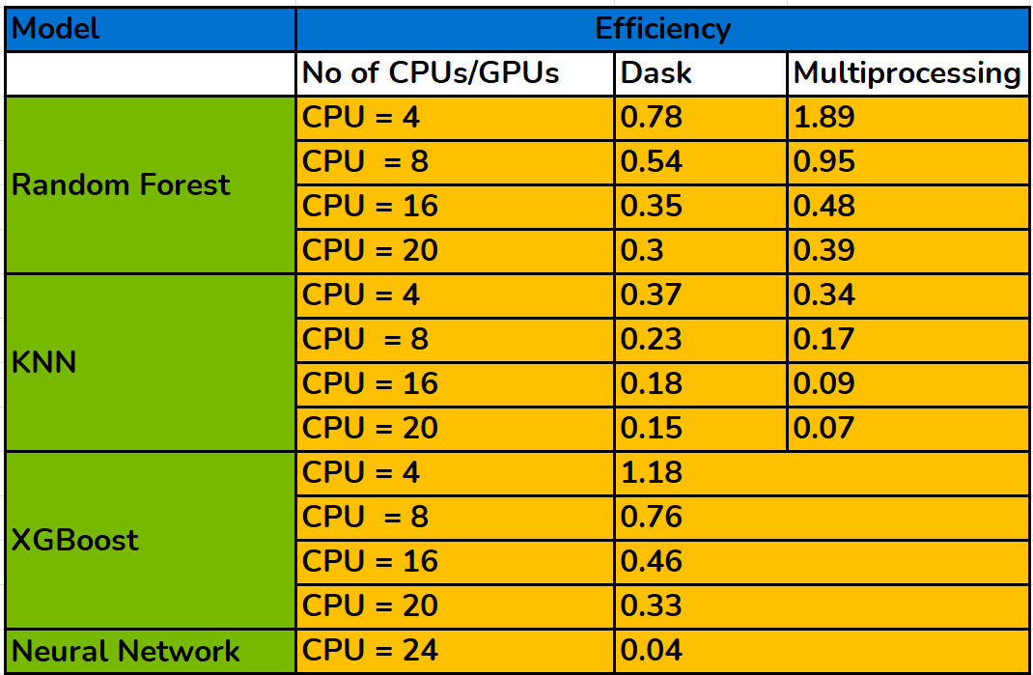
Efficiency

Slide 20
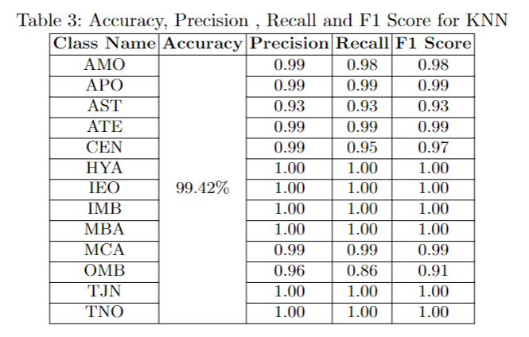
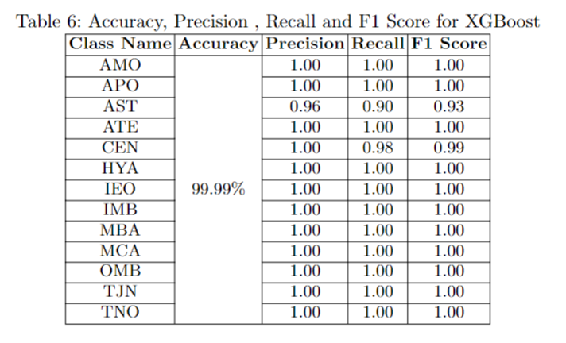
Accuracy
Our models achieved high accuracy (above 99%) for asteroid classification using Random Forest, KNN, and XGBoost algorithms.
The above table accuracies are from research paper which are similar to our models. [1]
It's important to consider potential overfitting, which can occur when models memorize training data specifics and perform poorly on unseen data. Our focus prioritized parallelization for faster training over extensive hyperparameter tuning to mitigate overfitting.

Slide 21
Conclusion
1
Key Insights
2
Parallel Computing Advantages
When using multiprocessing to parallelize a function, the cost of overhead needs to be considered, otherwise it may not be as effective as serial execution
Proper use of Dask Dataframe can significantly improve the computation time of Pandas. Using Multi-GPUs to train and Evaluate the model for faster computation.
3
Future Directions
4
Broader Impact
Discuss potential enhancements, such as leveraging GPU acceleration, to further optimize the system.
This can pave way for further faster estimates using the parallelization techniques as far as asteroid threats are concerned

Slide 22
References
[1] Hossain, Mir Sakhawat & Zabed, Md. (2023). Machine Learning Approaches for Classification and Diameter Prediction of Asteroids dx.doi.org/10.1007/978-981-19-7528-8_4 Accessed 12 March 2024.
[2] Dhariwal, Kunal. “Pandas with Dask, for an Ultra-Fast Notebook.” Medium, Towards Data Science, 31 Oct. 2021, https://towardsdatascience.com/pandas-with-dask-for-an-ultra-fast-notebook-e2621c3769f.
[3] NASA. (2020, April). JPL Small-Body Database Search Engine. https://ssd.jpl.nasa.gov/tools/sbdb_lookup.html#/
[4] Dask Development Team. (n.d.). Dask DataFrame. Dask Documentation. https://docs.dask.org/en/stable/dataframe-create.html
[5] PyTorch. (n.d.). Documentation. https://pytorch.org/docs/stable/index.html

Slide 23
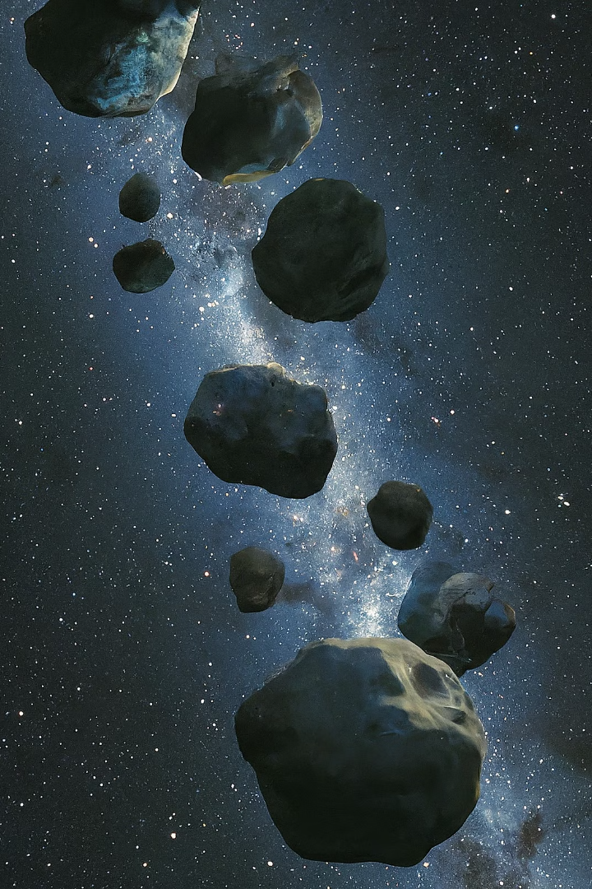
Thank you

